Slide 1




CALL CENTRE DASHBOARD
PRESENTED BY : HARSHA KADAM

Slide 2
INTRODUCTION
The Call Centre Dashboard provides a comprehensive analysis of customer interaction data collected through multiple communication channels. It helps monitor the performance, productivity, and customer satisfaction levels of call center operations. This Power BI dashboard visually represents important call metrics such as total calls, duration, sentiment, and reasons for contact across different states and days.

Slide 3
Dataset information
DATASET NAME : Call Centre Data
SOURCE : Public Dataset Kaggle
KEY COLUMNS : Call ID
Date
Day
State
City
Channel
Call Duration (min/hr)
Reason for Call
Sentiment
Response Time (%)
Call Centre Name

Slide 4
PROBLEM STATEMENT
KPI REQUIREMENTS
Total Calls : Measure overall customer engagement volume.
Total Call Duration (hrs/min) : Evaluate workload and handling time.
Average Call Duration : Determine call handling efficiency.
Response Time % : Assess service promptness.
CHART REQUIREMENTS
Total Calls by Day – Identify which days have the highest or lowest call volumes.
Total Calls by State – Visualize geographical distribution of calls.
Total Calls by Reason – Analyze top reasons customers contact the centre.
Total Calls by Channel – Compare communication preferences (Call, Email, Web, Chatbot).
Total Calls by Sentiment – Evaluate customer satisfaction and emotional tone.
Total Calls by Call Centre – Compare performance among different call centre.

Slide 5
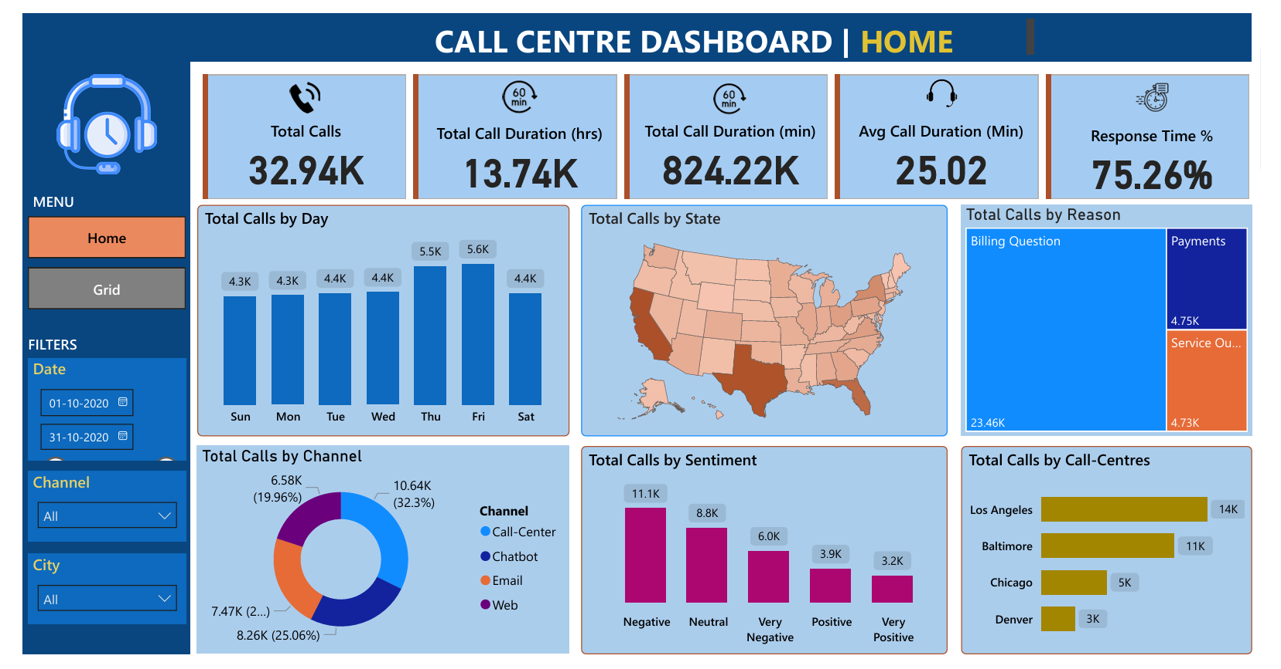

Slide 6
KEY FINDINGS
High call load observed on Thursdays and Fridays.
Billing queries are the main reason for calls, indicating potential billing confusion or issues.
Negative sentiment is notably higher — a key area for service quality improvement.
Los Angeles and Baltimore centres handle the bulk of customer calls — they may require more staffing or automation support.
Call duration averages 25 minutes, which could indicate complex issues or long handling times.

Slide 7
CONCLUSION
The dashboard successfully visualizes and monitors the call centre’s operational metrics. It highlights that:
Customer service teams face heavy call traffic mid-to-late week.
Billing-related issues dominate customer concerns.
Sentiment trends point to a need for better communication and faster issue resolution.
Call distribution insights can help optimize staffing, improve response time, and increase customer satisfaction.

Slide 8
THANK YOU

